Slide 1
Digital Circuit Design and Analysis
115-1
SOC Architecture and System Integration
Chung-An Shen(沈中安)
Department of Electronic and Computer Engineering
National Taiwan University of Science and Technology
Notes:
Time Table:
Slide 1 to 6 5min
Slide 7-9 4min
Slide 10-12 5min
Slide 13 1min

Slide 2
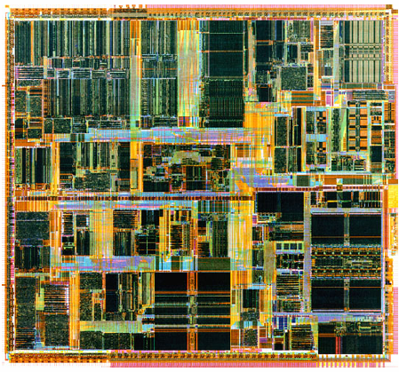
Fundamental Architecture of Electronic Systems
Application SW
apps、user interfaces、…
Software
Firmware
kernel、device driver、HW management 、…
digital circuits : processor、ASIC、FPGA、GPU…
Hardware
analog circuits : amplifier、oscillator…

Slide 3
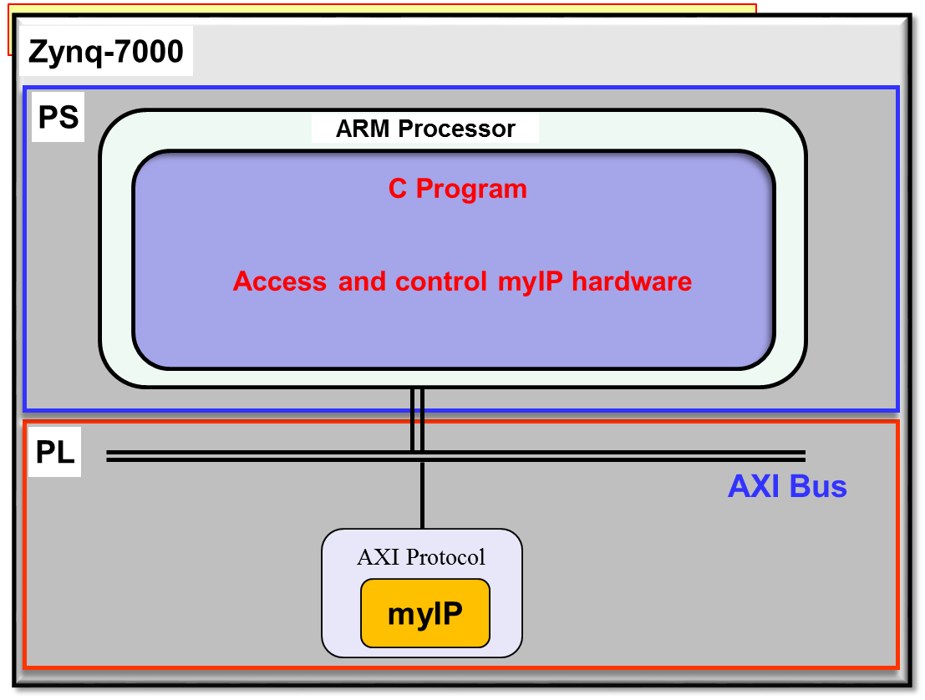
Fundamental Architecture of Electronic Systems
Integrate the processor, Bus, and the HW IP.
A software program (running on the processor) to access the HW IP.

Slide 4
Access HW from SW
Memory address space and Memory Map
Example:
The entire addressable space is architecturally divided into regions known as the Memory Map.
The Memory Map shows how the memory space is layout for the system.
For example, a processor with 32-bit address bus contains a memory map with 4GB.
Any components (registers, storages, elements…etc.) that are addressable (i.e. mapped on the memory map) can be read/written as if reading/writing a memory.

Slide 5
Access HW from SW
How to make an IP that is mapped onto the memory map.
Create the registers in the IP.
Connect the hardware signals of the IP to the Bus, which also connected to the processor.
Map the register of the IP to the memory map of the processor (i.e. creating memory mapped registers).
The IP can be accessed by the processor through the memory mapped registers as if reading/writing a memory space.

Slide 6
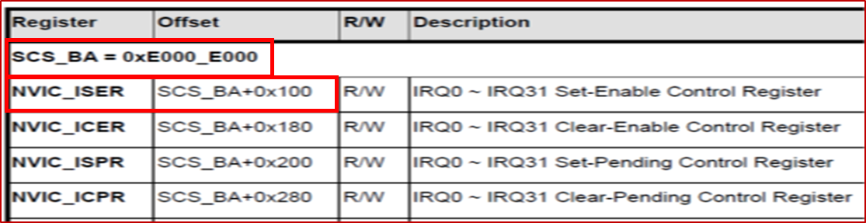
Access HW from SW
An Example
Assume it is written in the datasheet (or user manual):
The register NVIC_ISER is mapped to the address 0xE000_E100 (i.e. SCS_BA+0x100) in the memory map.
Reading/Writing the register NVIC_ISER is equivalent to reading/writing the address 0xE000_E100.
The exemplary C code:

Slide 7
On-chip Bus System
  AMBA: Advanced Microcontroller Bus Architecture
    AHB: Advanced High-performance Bus
    ASB: Advanced System Bus (obsolete)
    APB: Advanced Peripheral Bus
  AHB: Advanced High-performance Bus
    High performance and Pipelined operation
    Burst transfers
    Multiple bus masters
    Split transactions
  APB: Advanced High Peripheral Bus
    Low power
    Simple interface
  AXI: Advanced Extensible Interface
    The next-generation AMBA interface

Slide 8
On-chip Bus System
Introduction to AHB-Lite Bus
  Simple Master
  Simple Slaves

Slide 9
On-chip Bus System
Introduction to AHB-Lite Bus

Slide 10
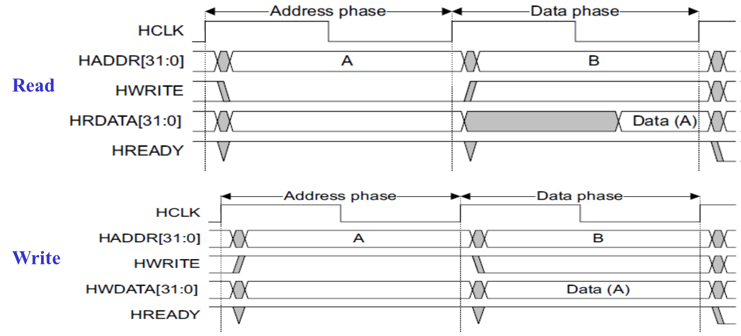
On-chip Bus System
Introduction to AHB-Lite Bus

Slide 11
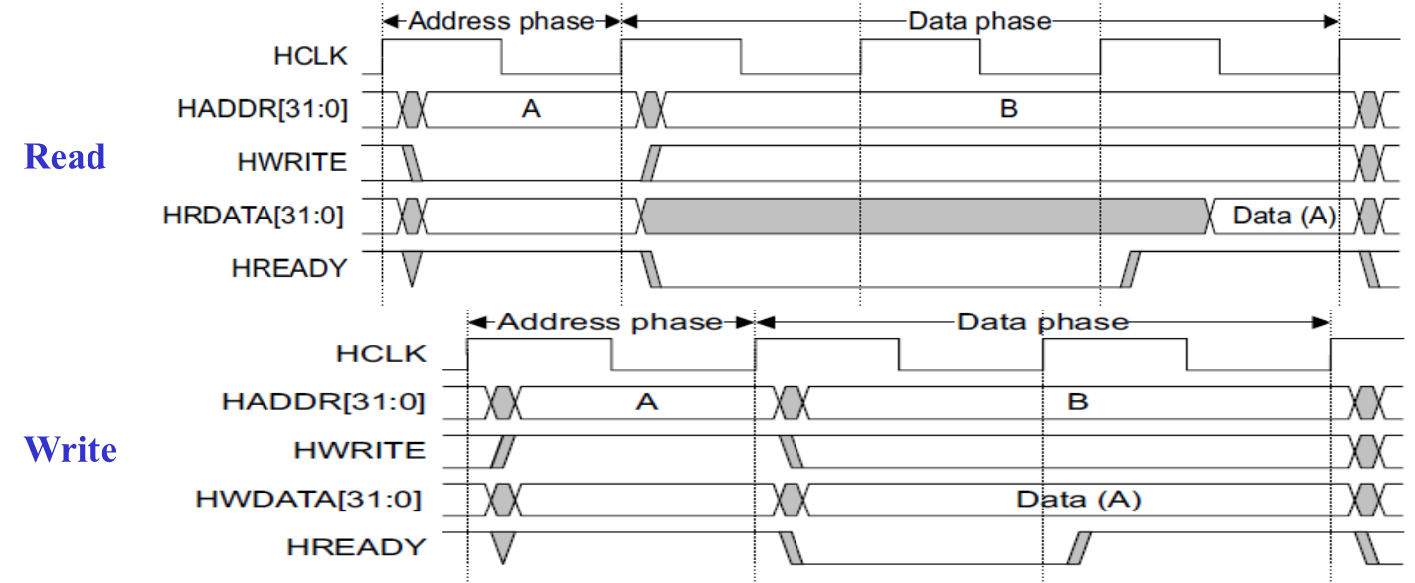
On-chip Bus System
Introduction to AHB-Lite Bus

Slide 12


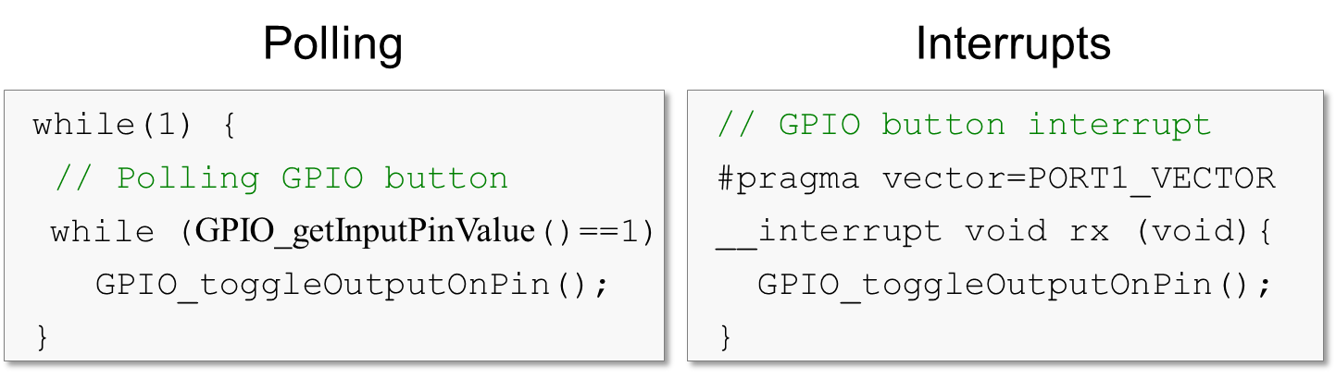
Interrupt and Interrupt Service Routine
How and hardware device (memory, IO, bus..etc) interact with software? (How to achieve HW/SW synchronization?)
  When a input device (HW) receives new data and wants the SW read this new data.
  When a output device (HW) is empty and wants to inform the SW that it can send a data out.

Slide 13
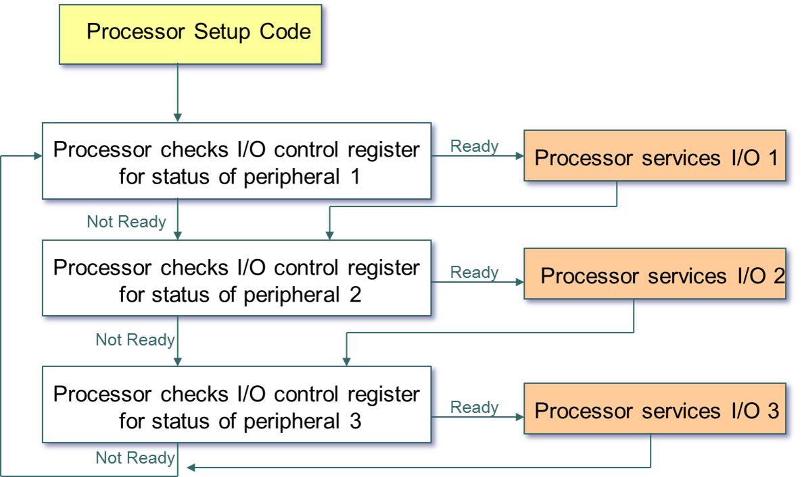
Interrupt and Interrupt Service Routine
Software Architecture based on Polling

Slide 14
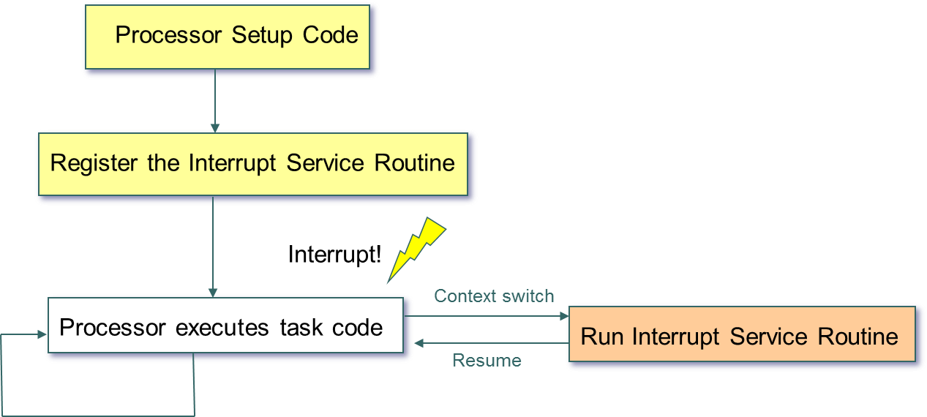
Interrupt and Interrupt Service Routine
Software Architecture based on Interrupt
  External hardware alerts the processor that input is
  ready.
  The processor suspends what it is doing.
  The processor invokes an interrupt service routine
  (ISR).
  ISR interacts with the application concurrently.

Slide 15
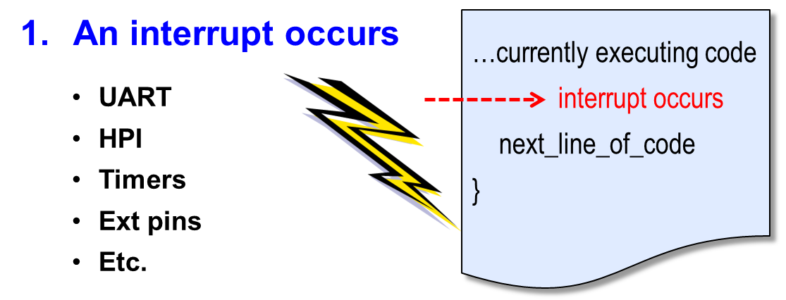

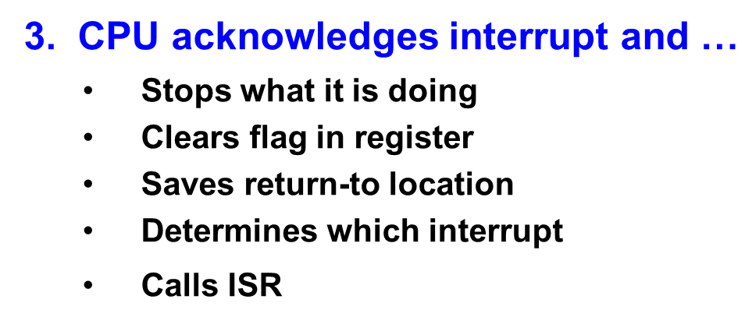
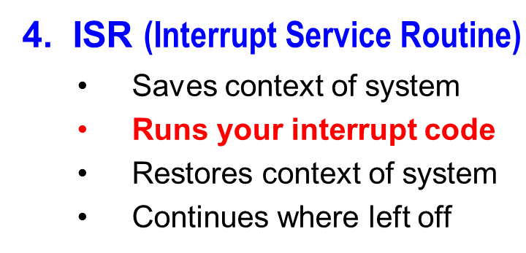
Interrupt and Interrupt Service Routine
In general, how does interrupt work?

Slide 16
Interrupt and Interrupt Service Routine
Typical using cases of HW/SW synchronization using interrupts
Input Device:
  HW request an interrupt when having a new data.
  SW (ISR) reads from the device and save it to the memory.
Output Device:
  HW request an interrupt when being idle.
  SW (ISR) reads data from memory and write to the device.

Slide 17
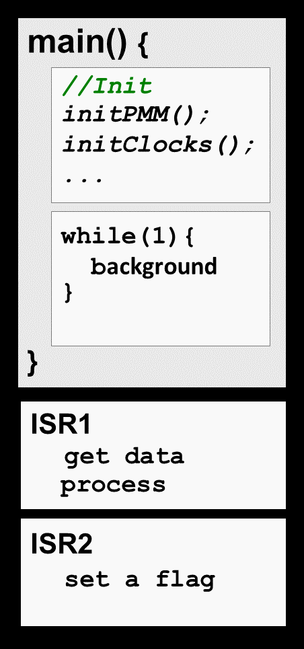
Interrupt and Interrupt Service Routine
Typical SW structure when using interrupts:
  Foreground / Background Scheduling
System Initialization
The beginning part of main() is usually dedicated to setting up your system
Background
Most systems have an endless loop that runs ‘forever’ in the background
In this case, ‘Background’ implies that it runs at a lower priority than ‘Foreground’
Foreground
Interrupt Service Routine (ISR) runs in response to enabled hardware interrupt
These events may change modes in Background – such as waking the CPU out of low-power mode
ISR’s, by default, are not interruptible
Some processing may be done in ISR, but it’s usually best to keep them short

Slide 18



